Slide 1


Two Tricks That Will Make You A Ridiculously Productive C64 Demo Coder
trident / fairlight, phd

Slide 2
Productivity

Slide 3
2024: 300+ Demo Parts
Notes:
13:37: 100 parts, screentime 8 seconds per part on average, 183 files loaded from disk

Slide 4
Two simple techniques to improve productivity
Anonymous IRQ handlers
Protothreads

Slide 5
Anonymous IRQ Handlers

Slide 6
The problem
IRQ handlers quickly get messy

Slide 7
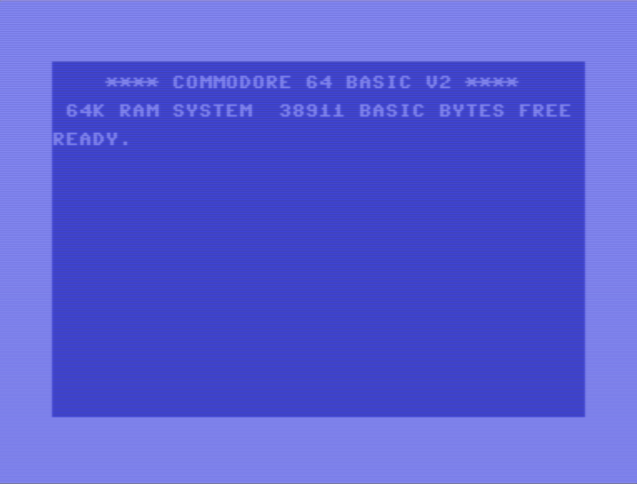
Background: IRQ (Interrupt ReQuest) Handlers
irq1
irq2
irq3

Slide 8
The Code
lda #<irq1
sta $fffe
lda #>irq1
sta $ffff
lda #$50
sta $d012
irq1:
jsr dosomething
lda #<irq2
sta $fffe
lda #>irq2
sta $ffff
lda #$c0
sta $d012
rti

Slide 9
The Code
irq2:
jsr dosomethingelse
lda #<irq3
sta $fffe
lda #>irq3
sta $ffff
lda #$f8
sta $d012
rti
irq3:
jsr opentheborder
jsr playmusic
lda #<irq1
sta $fffe
lda #>irq1
sta $ffff
lda #$40
sta $d012
rti

Slide 10
The Code
irq1:
jsr dosomething
lda #<irq2
sta $fffe
lda #>irq2
sta $ffff
lda #$c0
sta $d012
rti
irq2:
jsr dosomethingelse
lda #<irq3
sta $fffe
lda #>irq3
sta $ffff
lda #$f8
sta $d012
rti
irq3:
jsr opentheborder
jsr playmusic
lda #<irq1
sta $fffe
lda #>irq1
sta $ffff
lda #$40
sta $d012
rti

Slide 11
A macro
.macro irq_set(name, rasterline) {
lda #<name
sta $fffe
lda #>name
sta $ffff
lda #rasterline
sta $d012
}

Slide 12
The Code, Simplified
irq1:
jsr dosomething
irq_set(irq2, $c0)
rti
irq2:
jsr dosomethingelse
irq_set(irq3, $f8)
rti
irq3:
jsr opentheborder
jsr playmusic
irq_set(irq1, $40)
rti

Slide 13
The Mess
irq1:
jsr dosomething
irq_set(irq2, $c0)
rti
irq2:
jsr dosomethingelse
irq_set(irq3, $f8)
rti
irq3:
jsr opentheborder
jsr playmusic
irq_set(irq1, $40)
rti
irq_set(irq1b, $80)
irq_set(irq2b, $e0)
irq1b:
jsr dosomethingmore
irq_set(irq2, $c0)
rti
irq2b:
jsr dosomethingevenmore
irq_set(irq3, $f8)
rti

Slide 14
The Mess
irq1:
jsr dosomething
irq_set(irq2, $c0)
rti
irq2:
jsr dosomethingelse
irq_set(irq3, $f8)
rti
irq3:
jsr opentheborder
jsr playmusic
irq_set(irq1, $40)
rti
irq_set(irq2, $80)
irq_set(irq1b, $c0)
irq_set(irq1b, $80)
irq_set(irq2b, $e0)
irq1b:
jsr dosomethingmore
irq_set(irq2, $c0)
rti
irq2b:
jsr dosomethingevenmore
irq_set(irq3, $f8)
rti
irq_set(irq2b, $e0)

Slide 15
Anonymous IRQ Handlers
irq:
irq_wait($40)
jsr dosomething
irq_wait($80)
jsr dosomethingelse
irq_wait($c0)
jsr dosomethingmore
irq_wait($e0)
jsr dosomethingevenmore
irq_wait($f8)
jsr opentheborder
jsr playmusic
irq_set(irq, 0)
rti
Notes:
Overhead: 0 cycles – 0 memory

Slide 16
Anonymous IRQ Handlers
irq:
irq_wait($40)
jsr dosomething
irq_wait($80)
jsr dosomethingelse
irq_wait($c0)
jsr dosomethingmore
irq_wait($e0)
jsr dosomethingevenmore
irq_wait($f8)
jsr opentheborder
jsr playmusic
irq_set(irq, 0)
rti
irq_wait($70)
jsr dosomethingmore
jsr dosomethingelse

Slide 17
Implementation of Anonymous IRQ Handlers
.macro irq_wait(rasterline) {
lda #<next
sta $fffe
lda #>next
sta $ffff
lda #rasterline
sta $d012
rti
next:
}
.macro irq_set(name, rasterline) {
lda #<name
sta $fffe
lda #>name
sta $ffff
lda #rasterline
sta $d012
}

Slide 18
Loop over IRQs
irq:
lda #$40
sta rasterline
loop:
irq_wait(rasterline)
jsr dosomething_every_8th_line
lda rasterline
clc
adc #8
sta rasterline
cmp #$f8
bcc loop
jsr playmusic
irq_set(irq, 0)
rti
irq:
lda #$40
sta rasterline
loop:
irq_wait(rasterline)
jsr dosomething_every_8th_line
irq_wait(rasterline + 4)
jsr something_4_lines_after
lda rasterline
clc
adc #8
sta rasterline
cmp #$f8
bcc loop
jsr playmusic
irq_set(irq, 0)
rti

Slide 19
Anonymous IRQ Handlers
A gamechanger
No more irq2b/irq2c/irq2d
Readable code
Editable code
Dynamic IRQs are easy
No overhead

Slide 20
Full Code
.macro irq_wait(rasterline) {
lda #<next
sta $fffe
lda #>next
sta $ffff
lda #rasterline
sta $d012
lda $d011
and #$7f
ora #((rasterline & $100) >> 1
sta $d011
irq_restore()
next:
irq_save()
}
.macro irq_save() {
pha
txa
pha
tya
pha
lda $01
pha
lda #$35
sta $01
}
.macro irq_restore() {
asl $d019
pla
sta $01
pla
tay
pla
tax
pla
rti
}

Slide 21
Sequencing Actions with Protothreads

Slide 22
Problem: How to Make Things Happen in the Right Order
Show the logo after 2 seconds
Show the text after 1 second
Start the scroll after 4 seconds
Switch the logo when the beat starts
Fade out logo after 10 seconds
Fade out the text after 0.5 seconds
Fade out the scroll after 1 second
Notes:
Technique from back in the day: control bytes in the scroll text

Slide 23
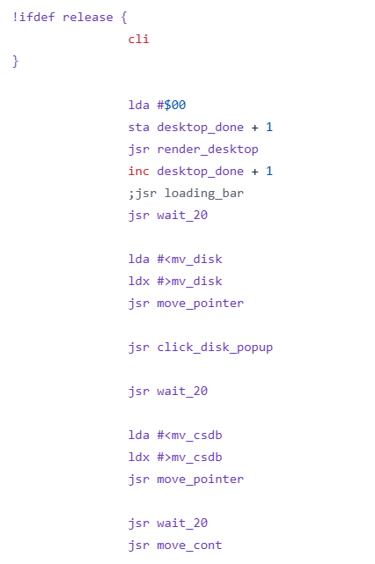
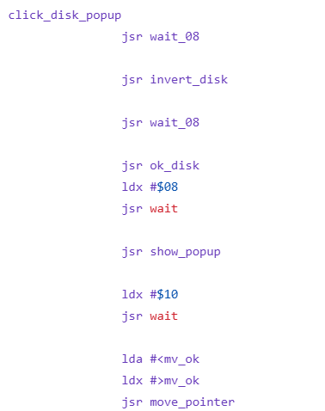
Example: Next Level / Performers (2023)

Slide 24
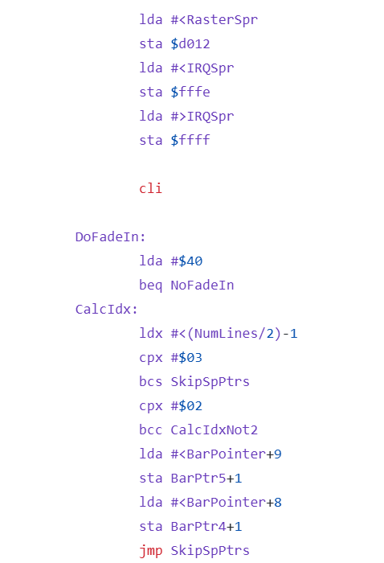
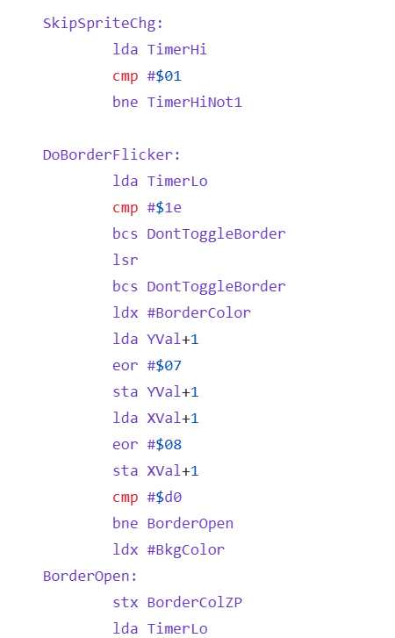
Example: No Bounds / Genesis Project (2023)

Slide 25
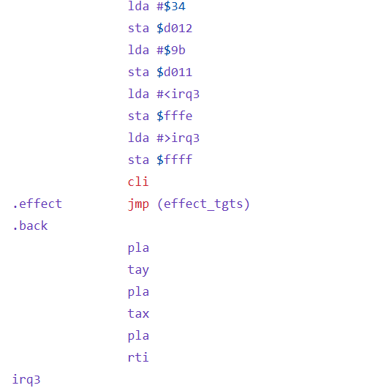
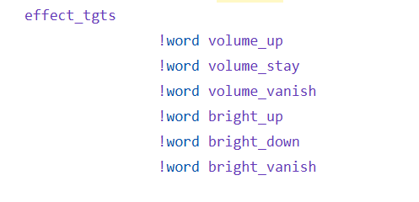
Example: Next Level / Performers (2023)

Slide 26
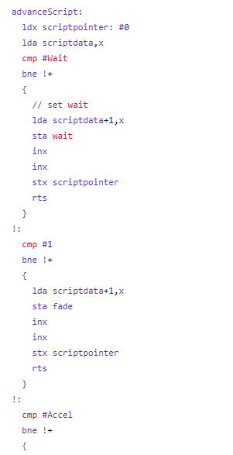
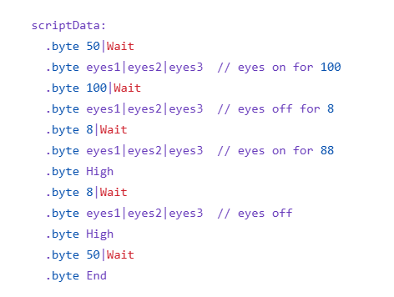
Example: Halloweed 4 / Xenon (2024)

Slide 27
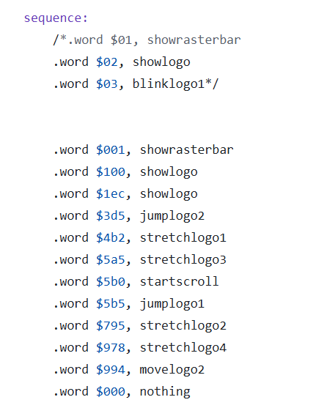
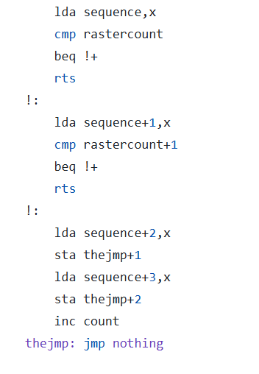
Example: Orbit Untold / Fairlight (2022)

Slide 28
Sequencing with Protothreads
Show the logo after 2 seconds
Show the text after 1 second
Start the scroll after 4 seconds
sequence:
pt_wait(pt, 2 * 50)
jsr showlogo
pt_wait(pt, 1 * 50)
jsr showtext
pt_wait(pt, 4 * 50)
jsr startscroll
Notes:
Overhead: 1 instruction, 5 cycles, 2 bytes of memory

Slide 29
Calling the Protothread
irq:
irq_wait($ff)
jsr playmusic
jsr sequence
irq_set(irq, 0)
rti
sequence:
pt_wait(pt, 2 * 50)
jsr showlogo
pt_wait(pt, 1 * 50)
jsr showtext
pt_wait(pt, 4 * 50)
jsr startscroll
jmp (pt)

Slide 30
Protothreads: Under the Hood
sequence:
jmp (pt)
pt_wait(pt, 2 * 50)
jsr showlogo
pt_wait(pt, 1 * 50)
jsr showtext
pt_wait(pt, 4 * 50)
jsr startscroll
.macro pt_wait(pt, ticks) {
lda #<again
sta pt
lda #>again
sta pt + 1
again:
count: lda #0
inc count + 1
cmp #ticks
beq done
rts
done:
}

Slide 31
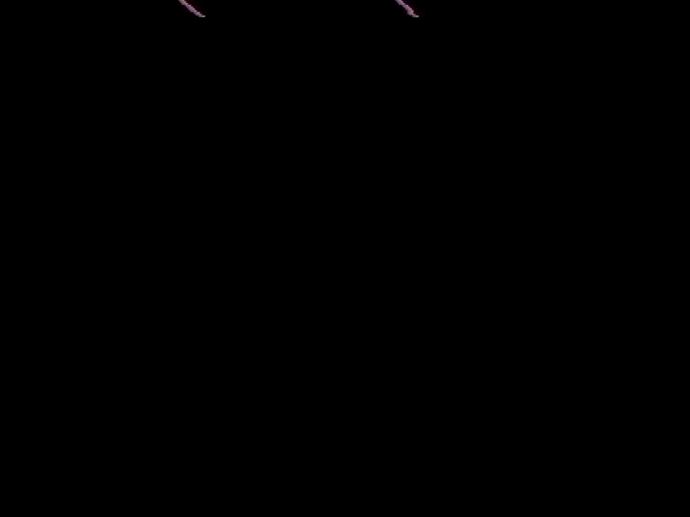
Example: Dough Crooks (degkrokarna) from The Ghost (Fjälldata 2024)

Slide 32
Example: Dough Crooks (degkrokarna) from The Ghost (Fjälldata 2024)
PT_CALL(pt, fadein)
PT_YIELD_TICKS(pt, 1.5 * 50)
PT_YIELD_SHIFTLOCK(pt)
PT_CALL(pt, fadecolor)
PT_YIELD_TICKS(pt, 1.5 * 50)
PT_CALL(pt, flashout)
lda #$3
sta $d01d
PT_CALL(pt, flashin)
PT_YIELD_TICKS(pt, 5.7 * 50)
PT_YIELD_SHIFTLOCK(pt)
PT_CALL(pt, fadeout)

Slide 33
Sequencing with Protothreads
A gamechanger
Fade ins / fade outs / transitions are now super easy
Readable code
Editable code
Very low overhead

Slide 34
Bonus Trick: Stackable IRQs
Set up next interrupt + acknowledge interrupt before calling long-running code
Flag to avoid calling code on top of each other
irq_wait($80)
jsr do_something_real_quick
irq_wait_jsr($ff, long_running_code)
jsr playmusic

Slide 35
Summary: Two Tricks for Productivity
Anonymous IRQ handlers
irq_wait($40)
jsr rasterbar
Sequencing with protothreads
pt_wait(pt, 5 * 50)
jsr showlogo

Slide 36
Questions?

